Slide 1
Chapter 55

Slide 2
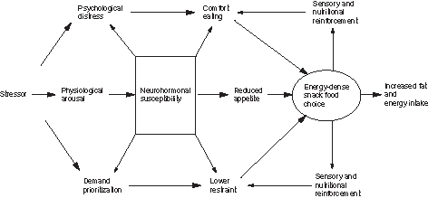
Figure 1 Biobehavioral pathways linking stress to changes in food choice and intake.

